Slide 1
Digital Techne Software
Physical Artwork Archive:
DNA ink
Multimedia (metadata and media files)
Confidentiality using strong crypto
Blockchain transactions (add, lend)
Digital Art:
cloning (print run, tokenization)
Marketplace integration
Blockchain transactions (add, trade)

Slide 2
Physical Artwork
Multimedia archive: easy browsing among public, private and lended dossier, holding artwork info
Confidentiality on non public dossier
Time based access to lended dossier
Personal identity and BC wallet are decoupled
Owner of the dossier can be anonymous
BC interactions from the Front End only

Slide 3
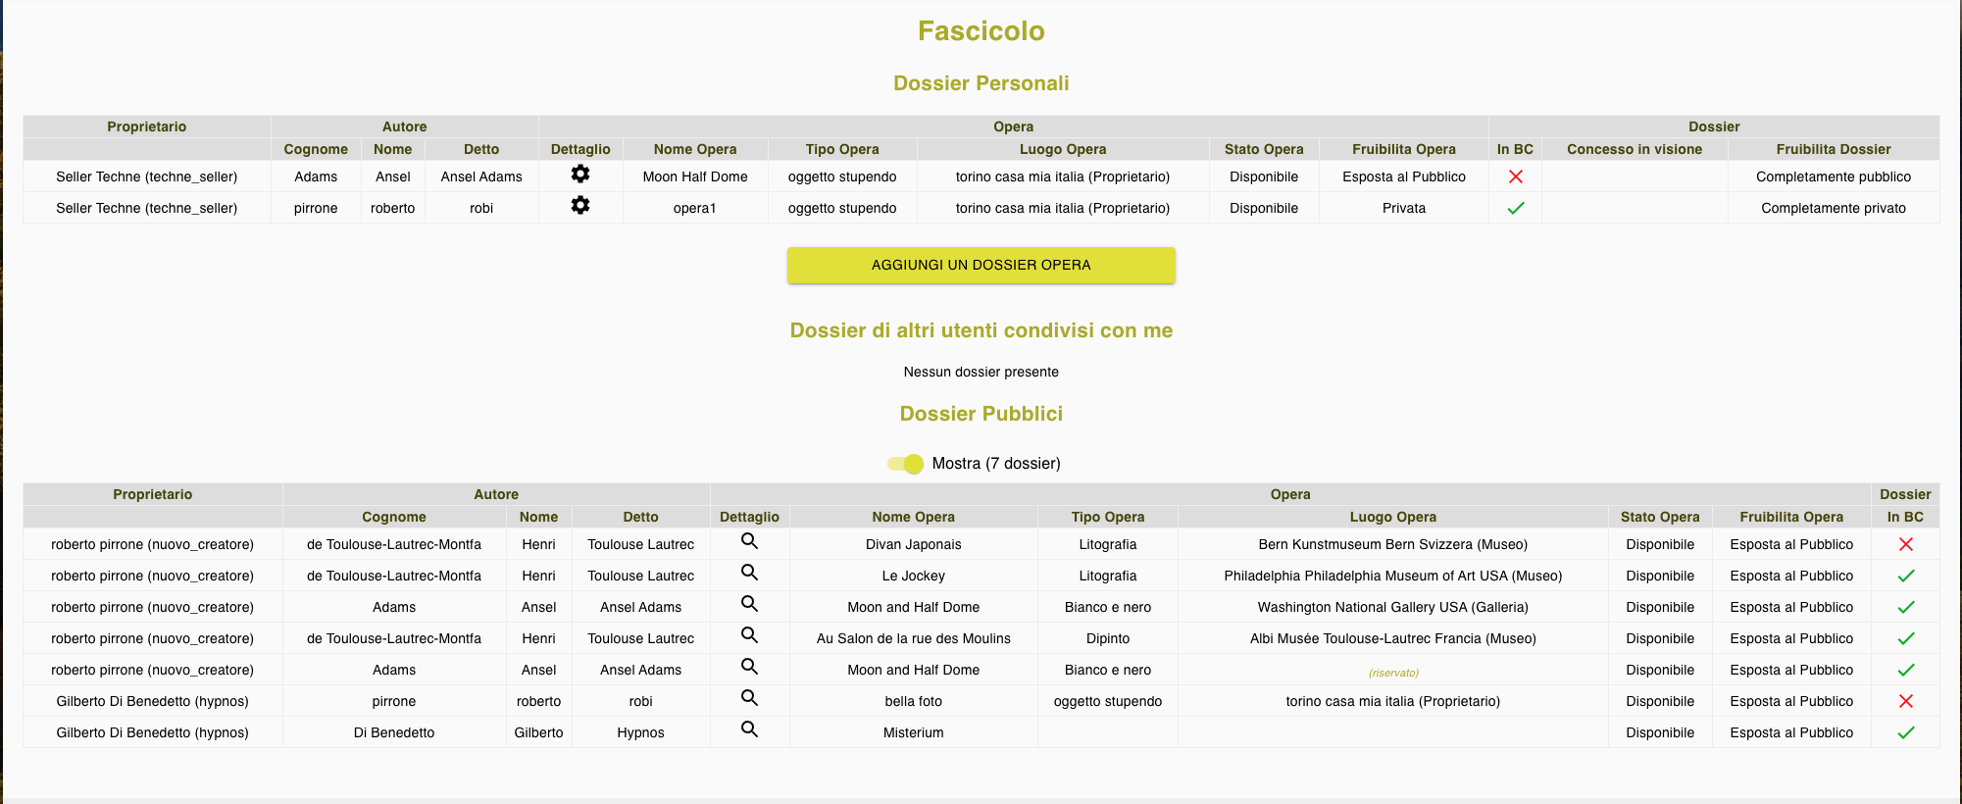
Physical Artwork

Slide 4
Digital Artwork
Streamline the easy cloning of digital artwork
Time consuming, Back End driven
Instead of attributes change (i.e. Bored Apes Yacht Club), customize each image in two possible ways:
Tokenization: split image in smaller rectangles, outline the active rectangle, blur the remaining image
Print run: imprint the number of the copy and the artist’s signature on the image

Slide 5
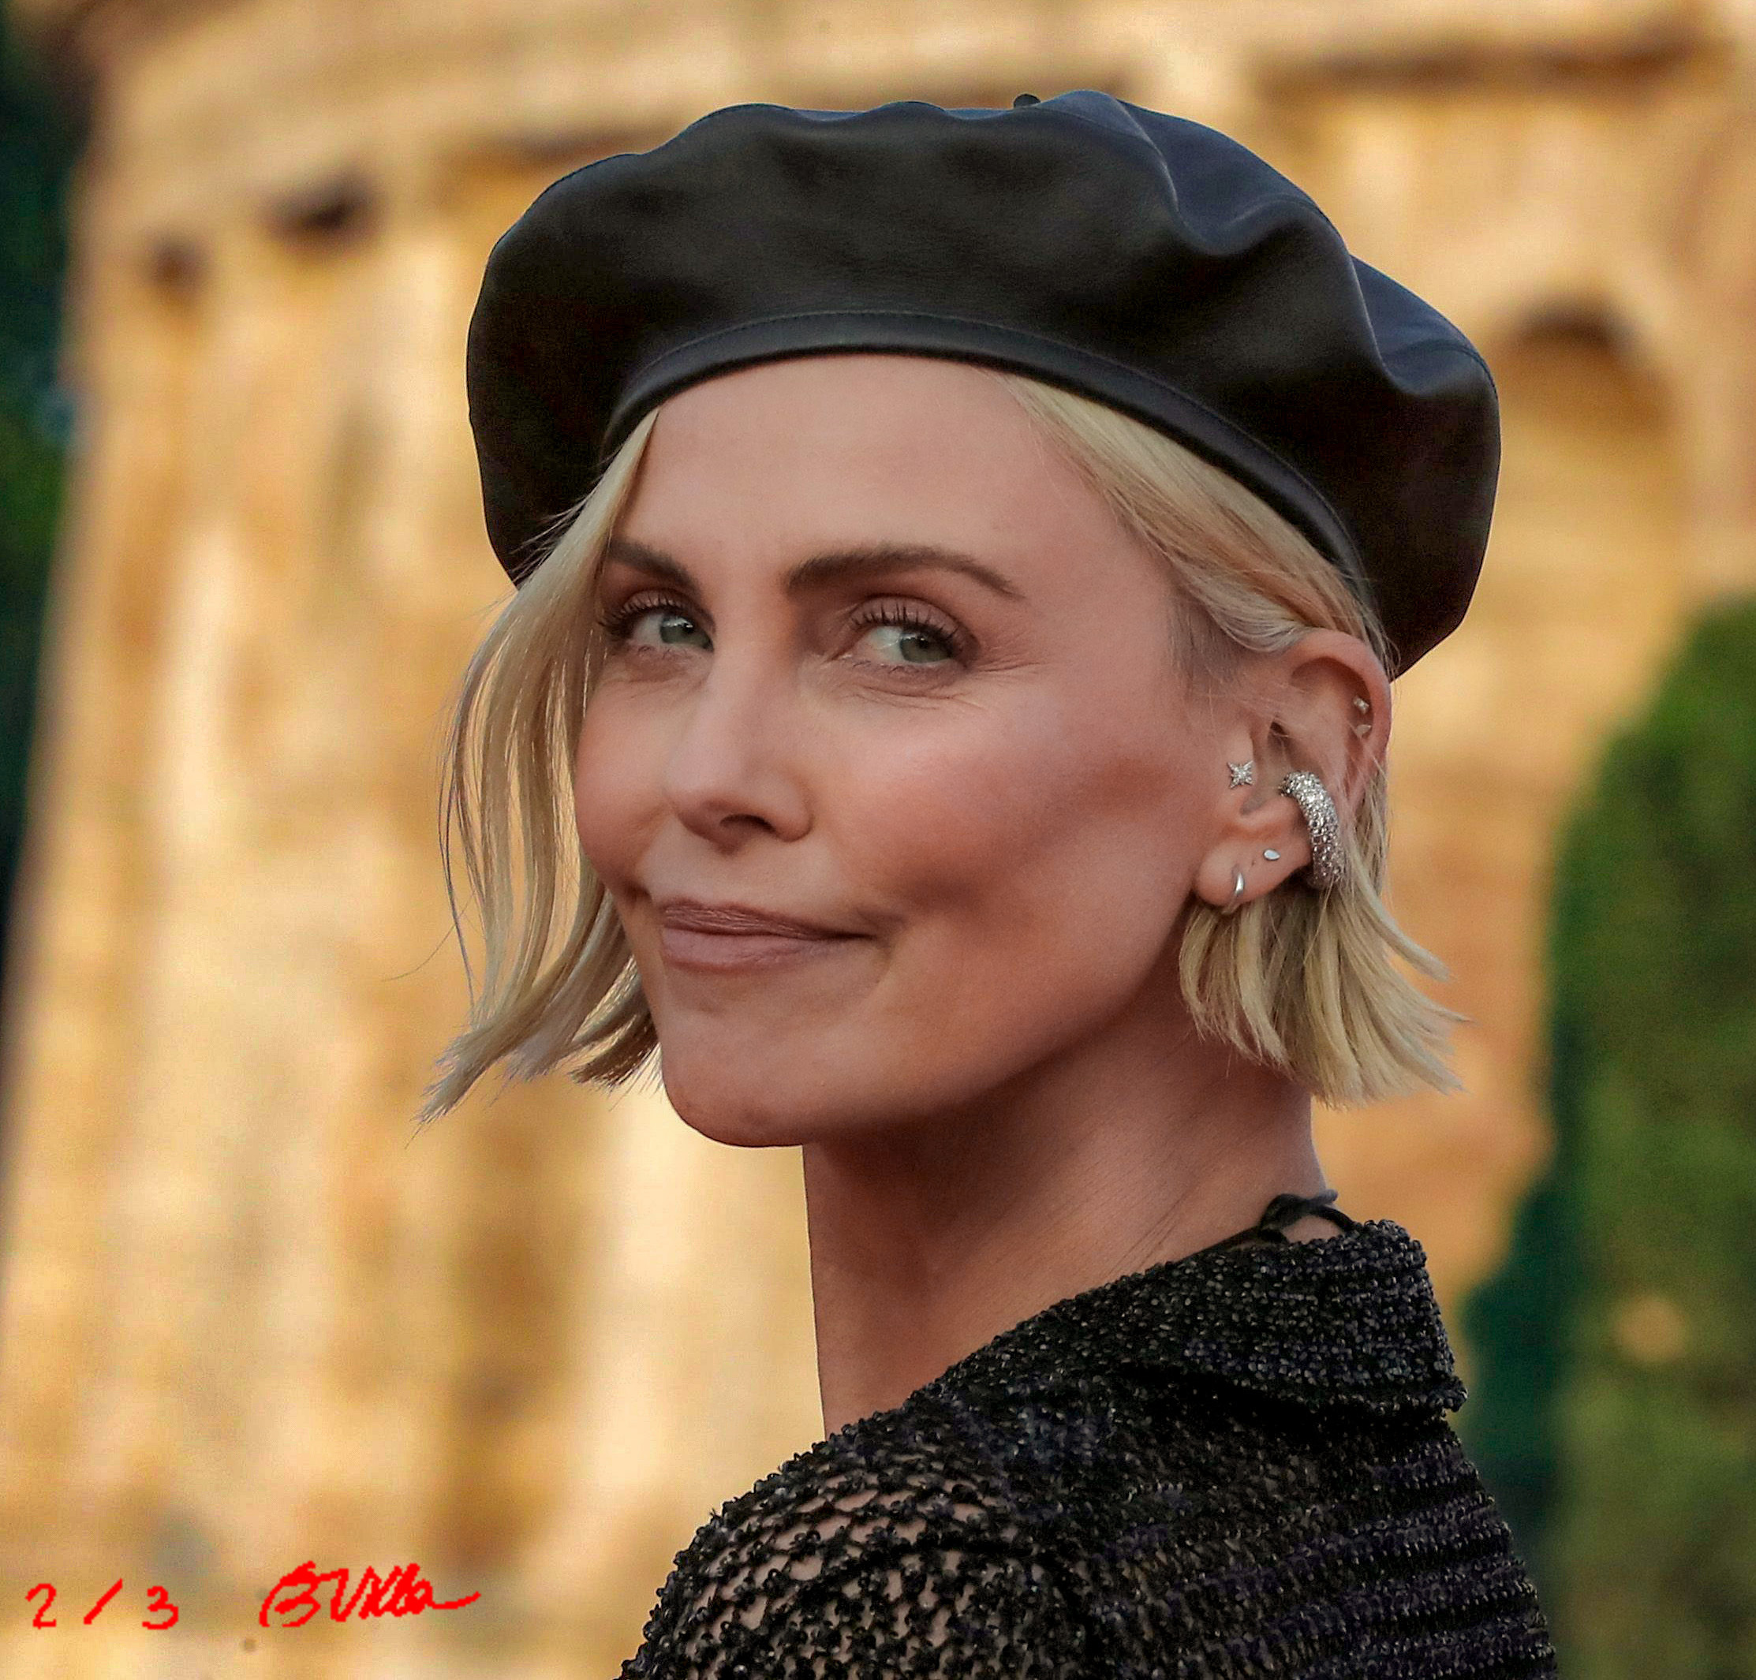
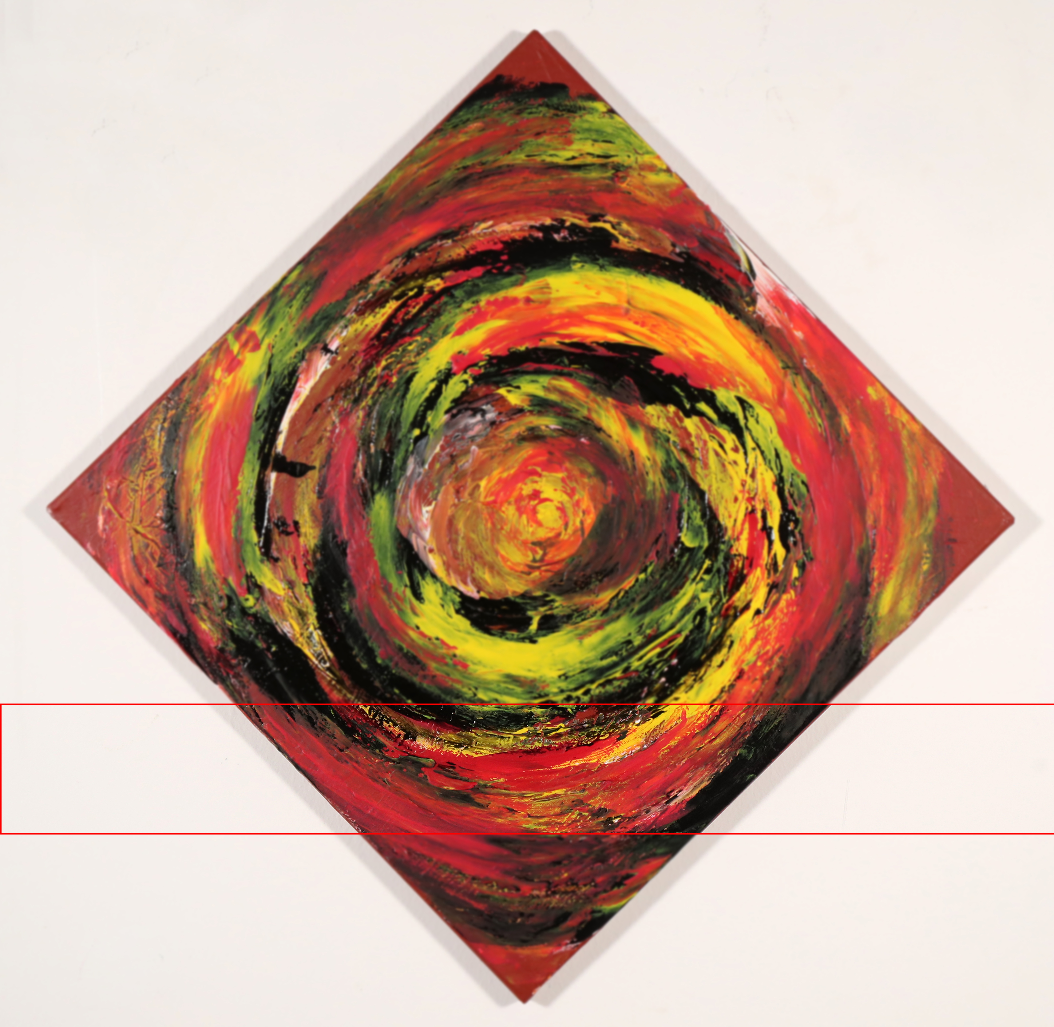
Print run and tokenization

Slide 6
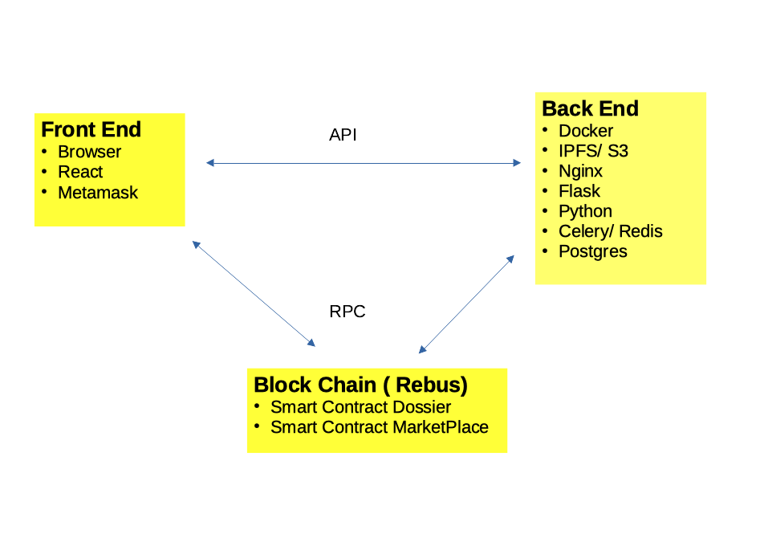
Software Structure

Slide 7
ICP potential benefits
More intuitive interaction for Dapp applications
Platform native integration of:
Cheap storage
Identity handling

